Slide 1


Integrated Safe School Plan (ISSP) Public Meeting
School Name
September/October date, 2025
Add school logo
Notes:
Facilitator:
Conducts Welcome/Introductions.
States that the purpose of this meeting is to support parents and the school community in developing a general awareness of school safety procedures, including how students will be reunited in actual disasters. It will also provide an opportunity to express an opinion about the school safety plan.
States that this is the public meeting required by ed code to review, discuss, and allow comments on the school’s plan and emergency procedures.
Background for facilitator/not necessary to share:
- The public meeting is required by Ed Code 32288.

Slide 2

Agenda
Purpose of ISSP
Process for Updating ISSP
Key ISSP Components
Accessing the Print ISSP
Opportunities for Involvement
Resources
Questions and Public Comment
School’s ISSP Contact
Notes:
Facilitator states:
Facilitator reads/allows participants to read agenda items.
Staff and the ISSP contact in particular will be available for future questions beyond today’s session.

Slide 3
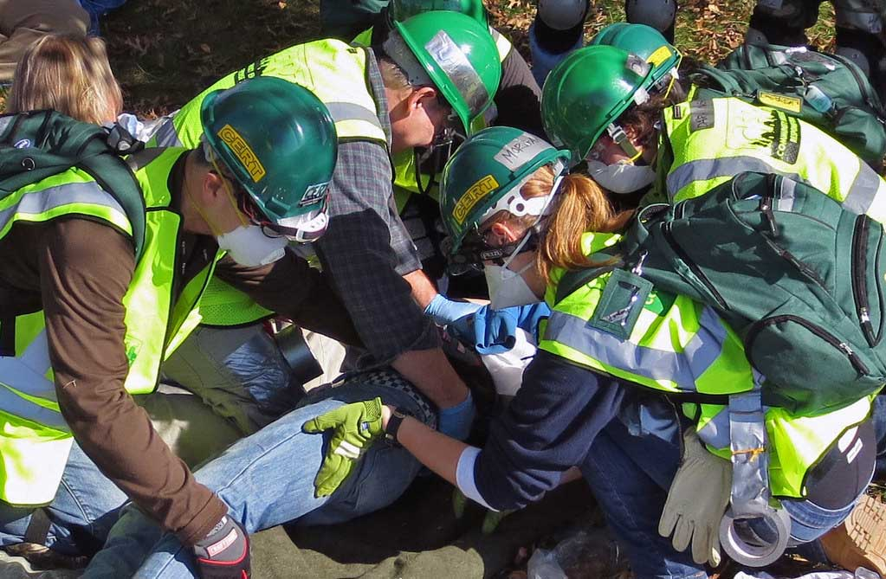
Purpose of ISSP
Provides school’s emergency response information, such as:
  Emergency team composition and locations
  Emergency bin location
  Emergency water treatment date
  Training/public meeting information
  School maps
Includes non-emergency District procedures in the areas of:
  Campus security
  Plant inspections
  Violence prevention/intergroup relations
  Behavior/discipline
  Facilities
  School arrival/departure
  Attendance
Required by Ed Code (32280-32288)
Notes:
Facilitator shares:
ISSP contains mostly standardized language reflecting District policy and protocols related to large-scale emergencies and overall student safety.
Examples of the procedures included in the ISSP (and provided by the District for Districtwide uniformity) are earthquake, lockdown, animal disturbance, and explosive device threat procedures, as well as threat assessment, digital citizenship and cybersecurity policy and protocols.
Schools only need to review and update or complete a limited number of fields in the online ISSP. (Listed on subsequent slide.)

Slide 4
Process for Updating the ISSP
Consists of a collaborative process led by the School Site Council or the School Safety Planning Committee (includes law enforcement representation)
Requires data-gathering and analysis by the school
Relies on District, online template with related policy/protocol embedded
School enters/reviews data for updates and maintains current hard copy
Requires annual (by October 1) and ongoing updates throughout the year
School’s current ISSP is available for review
Notes:
Facilitator reads/allows audience to read slides and states:
All required members complete the signature page to confirm a collaborative process.
Parents and community can request to view the final printed version available in the Main Office. (More details will follow.)
School staff have online access which includes access to the draft-under-development.
Background for facilitator/not necessary to share:
- For updates to be official and part of the current plan, the principal needs to resubmit the plan. The copy for public view would need to be replaced.

Slide 5
Process for Updating the ISSP
ISSP requires the following data be annually reviewed/updated or completed by the school:
School Site Council or School Safety Planning Committee members (the group responsible for updating the ISSP)
Assessments (in up to 12 areas, such as health services, staff wellness, campus safety, mandated reporting/notification, attendance/engagement, and parent/community engagement)
Goals and data summary (for attendance, school discipline, threat/hazard and emergency function)
Identifying emergency team members for 14 teams/positions, as well as the Incident Command, School Site Crisis and School Site Suicide/Threat Risk Assessment teams
Meeting locations for emergency teams
Notes:
Facilitator shares:
These are the fields schools need to review/update or complete in the online ISSP.

Slide 6
Process for Updating the ISSP
ISSP requires the following data be annually reviewed/updated or completed by the school:
Emergency bin location
Automatic External Defibrillator (AED) Location
Plans for loss of utilities
Offsite locations (used in situations which require evacuating from the school premises and relocating to an off-campus site)
Signature Page
Every School Safe training dates (topics include grooming awareness, substance use awareness, and cybersecurity)
Notes:
Facilitator shares:
These are the fields schools need to review/update or complete in the online ISSP.

Slide 7

ISSP
Notes:
Facilitator states:
This is the ISSP print document title page.
The ISSP is approximately 200 pages in length.
Each school has a unique ISSP based on its needs and resources and one which is annually updated as led by the School Safety Committee.
Background for facilitator/not necessary to share:
Content/length can vary since the District has 7 different ISSP templates (unique ones for adult education programs, early education centers and co-located schools).
Prior to the school updating the plan, the District also annually updates standardized language in the ISSP to reflect District policy and protocol changes.

Slide 8
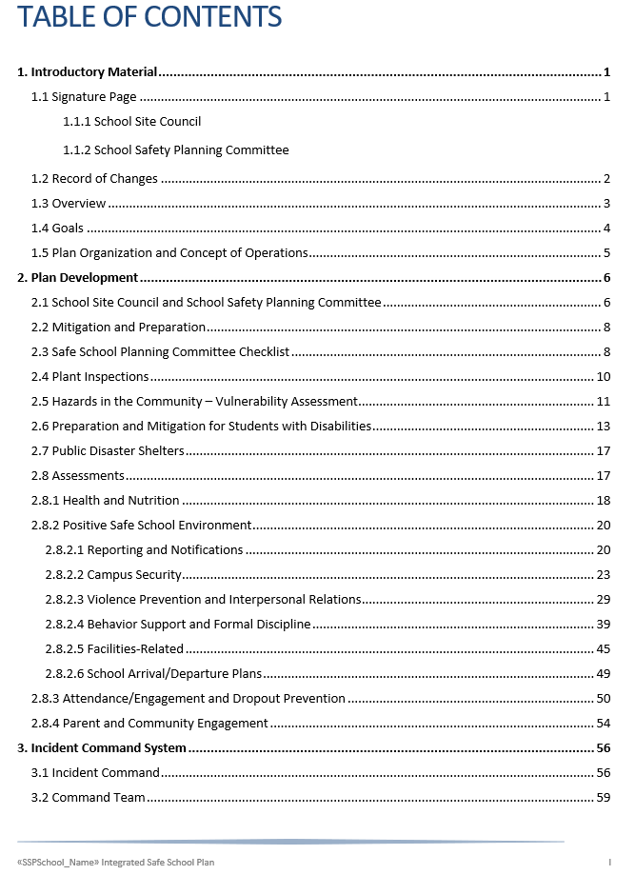
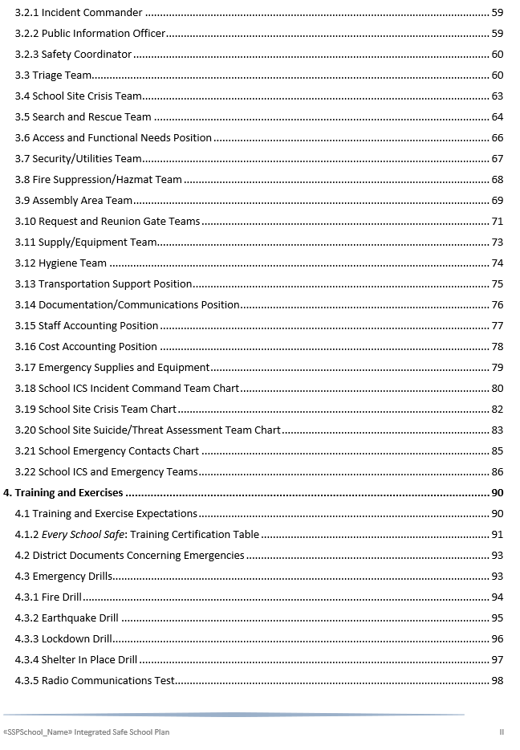
Notes:
Facilitator states:
To give you a better sense of the content and comprehensive nature of the ISSP, take a look at its table of contents. (You can display your school‘s actual table of contents from another screen.)
Sections include (school) plant inspections, vulnerability assessment, public disaster shelters, campus security, incident command system, parent and community engagement and legal requirements.

Slide 9
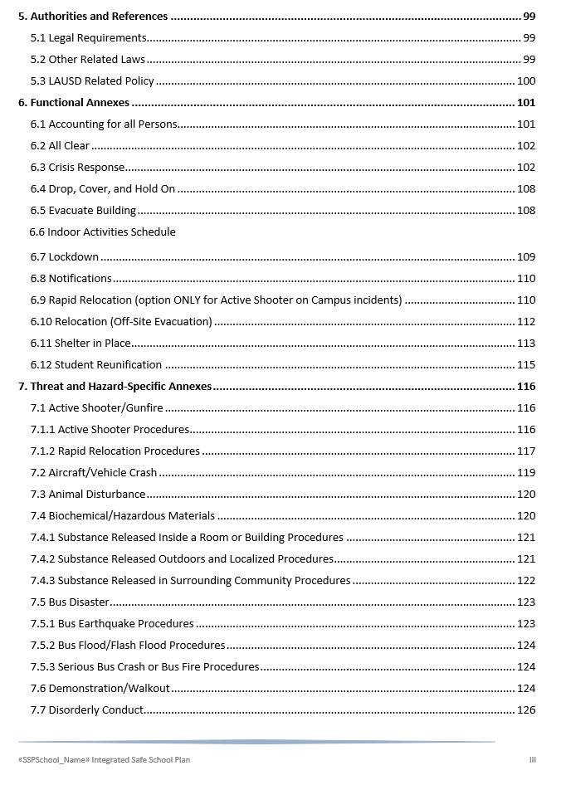
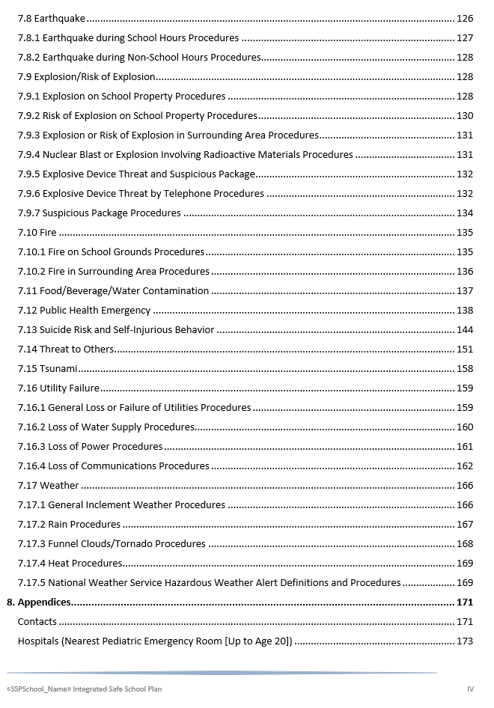
Notes:
Facilitator states:
- This is the continuation of the table of contents.
The majority of the language within the ISSP is provided by the District and based on law and/or District policy/protocols.
The District has other resources which also describe/summarize these procedures, including an Emergency Classroom Quick Guide posted in all our classrooms, offices and common areas which remind all of us of the procedures for required drills/most common threats. (Displayed in a subsequent slide.)

Slide 10
Process for Updating the ISSP
2025-26 School Site Council (Show this slide if applicable)
Required Team Member Position | Name
Principal | School enters specifics for this column
Non-Teacher School Personnel
Teacher
Teacher
Teacher
Parent (of an attending student)
Student (if secondary school)
LASPD/Law Enforcement Agency
Charter School Principal/Designee (if applicable)
Notes:
Facilitator states:
We will now explore some fields we update online in order to complete, submit and print our ISSP.
These are the required members of our 2025-26 School Site Council. (Facilitator should complete table prior to the training.)
The committee is the collaborative group that completes the Integrated Safe School Plan using this District-approved ISSP online template.
The School Safety Committee has a broad representation of all stakeholder groups (students, parents, staff, and community) including applicable co-located school representatives.

Slide 11
Process for Updating the ISSP
2025-26 School Safety Planning Committee
Required Team Member Position | Name
Principal | School enters specifics for this column
UTLA Representative
Classified Representative
Student Representative (secondary schools)
Parent (of attending student) Representative
LASPD/Law Enforcement Agency
Charter School Principal/Designee (if applicable)
Notes:
Facilitator states:
We will now explore some fields we update online in order to complete, submit and print our ISSP.
These are the required members of our 2025-26 School Safety Planning Committee. (Facilitator should complete table prior to the training.)
The committee is the collaborative group that completes the Integrated Safe School Plan using this District-approved ISSP online template.
The School Safety Committee has a broad representation of all stakeholder groups (students, parents, staff, and community) including applicable co-located school representatives.

Slide 12
Process for Updating the ISSP
2023-24 School Safety Committee
Suggested Team Member Position | Name
School completes both columns | School enters specifics for this column
Notes:
Facilitator states:
These are the suggested members of our 2024-25 School Safety Planning Committee. (Facilitator should complete table prior to the training.)

Slide 13
Process for Updating the ISSP
Our School’s ISSP Update Process:
When/how the school starts the process
Committee meeting schedule
Data/feedback considered for updating the ISSP
Assessment process school follows
Key lessons/successes/challenges
School adds logo, school image, etc.
Notes:
Facilitator shares more school specifics:
(Adds details to the slide prior to the meeting.) Shares some details about the process taken at school to update the ISSP. (Ideas for consideration are provided.)
Background for facilitator/not necessary to share:
- For updates to be official and part of the current plan, the principal needs to resubmit the plan. The copy for public view would need to be replaced.

Slide 14
Process for Updating the ISSP
Examples of 2025-26 Updates included in our School’s ISSP:
Add Example 1
Add Example 2
Add Example 3
School adds logo, school image, etc.
Notes:
Facilitator shares more school specifics:
(Adds details to the slide prior to the meeting.) Provides example(s) of updates that have taken place/may take place during the year (staffing changes requiring changes to emergency teams, water treatment date, safety series training completion dates, new offsite location, etc.).
Background for facilitator/not necessary to share:
- For updates to be official and part of the current plan, the principal needs to resubmit the plan. The copy for public view would need to be replaced.

Slide 15
Key ISSP Components
Functional Annexes
Accounting for All Persons | To account for the whereabouts and wellbeing of all students, staff members and visitors and is one of the first tasks that must be accomplished in any emergency
All Clear | To notify teachers that normal school operations can resume
Crisis Response | To address the social-emotional needs of students and staff
Drop, Cover, and Hold On | To protect students and staff from flying or falling debris, and is commonly used during an earthquake or explosion
Evacuate Building | Most commonly used in response to a fire, after an earthquake, or any emergency where the building and its contents are perceived to be a threat to student safety
Lockdown | To prevent the perpetrator from entering any occupied campus areas; students are to always remain in locked classrooms or designated safe locations
Notes:
Facilitator states:
We will now explore some emergency protocols from our ISSP. These are provided by the District.
These components are found in both the print and online versions of the ISSP
Functional annexes focus on operational functions and the courses of action developed to carry them out, independent of the threat or hazard requiring response. Many functions will occur consecutively and functions may be performed concurrently for different threats and hazards which will be discussed subsequently. We practice these actions during our regularly scheduled emergency drills. (Starting with some subsections from Functional Annexes, share examples as you deem relevant/necessary for your school community.)
Be assured that when the school evacuates, medications are also evacuated.
For schools with multiple stories: The facilitator may also mention that the school has an evacuation chair and staff has been trained on its use.
Background for facilitator/not necessary to share:
- The printed ISSP is organized differently than the online ISSP, though the content is mostly the same.

Slide 16
Key ISSP Components
Functional Annexes
Notifications | Sent to 911, LASPD Watch Commander, Region Operations, parents/staff through Blackboard Connect and iSTAR (District incident reporting platform)
Rapid Relocation | Students and staff are encouraged to quickly leave by any safe and available exit; if leaving campus, the established off-site relocation point is the preferred destination, if the route is safe
Relocation (Off-site Evacuation) | When authorities have determined that it is unsafe to remain on the campus and evacuation to an off-site relocation site is required; does not apply during an active shooter incident, a tsunami, or large hazardous materials release
Shelter In Place | To place and/or keep students indoors to provide a greater level of protection from airborne contaminants in outside air, inclement weather, or other hazards
Student Reunification | To reunite students with their custodial adult after a critical incident or disaster
Notes:
Facilitator states:
These are additional functional annexes.

Slide 17
Key ISSP Components
Threat and Hazard-Specific Annexes
Active Shooter/Gunfire | Involves one or more individuals on school grounds who is armed with a firearm and has already killed or wounded someone with the firearm AND at least one of the following applies: continues to shoot others; actively seeks or attacks others; has access to additional victims
Aircraft/Vehicle Crash | An aircraft or motor vehicle crash on or near school property
Animal Disturbance | Implemented when a dog, coyote, mountain lion, or other wild animal threatens the safety of students and staff
Biochemical/ Hazardous Materials | Involves the discharge of a biological or chemical substance in a solid, liquid, or gaseous state; common releases within or adjacent to schools include the discharge of chemicals in a school laboratory, an overturned truck of hazardous materials in proximity of the school, or an explosion at a nearby oil refinery or other chemical plant
Bus Disaster | Earthquake, serious bus accident, or other emergency that occurs while students are on a school bus field trip or being transported to or from school
Notes:
Facilitator states:
We will now explore some threat/hazard procedures. The corresponding protocols are provided by the District.
The threat- and hazard-specific annexes describe the courses of action unique to particular threats and hazards. These annexes were developed at the District level, based on risk analyses.

Slide 18
Key ISSP Components
Threat and Hazard-Specific Annexes
Demonstration/ Walkout | Any assemblage on or off campus by staff or students for the purpose of protest or demonstration
Disorderly Conduct | Conduct may involve a student, staff member, or visitor exhibiting threatening or irrational behavior
Earthquake | Generally occur without warning and may cause minor to serious ground shaking, damage to buildings, and injuries
Explosion/Risk of Explosion | Includes protocols for: explosion on school property, risk of explosion on school property, explosion or risk of explosion in surrounding area, nuclear blast or explosion involving radioactive materials, and explosive device threat/suspicious package
Notes:
Facilitator states:
These are additional threat/hazard procedures.

Slide 19
Key ISSP Components
Threat and Hazard-Specific Annexes
Fire | Impacts a school if it occurs on campus or in an off-campus location near the school
Food/Water Contamination | When site personnel report suspected contamination of food or beverages served for the various food programs; applies where there is evidence of tampering with food packaging, observation of suspicious individuals in proximity to food or beverage supplies, or if notified of possible food contamination by Central District staff or local agencies
Public Health Emergency | Involves an infectious disease outbreak or a pandemic which requires a large-scale emergency need for medical health care services
Suicide Risk and Self-Injurious Behavior | Concerns or incidents should be directly reported to the administrator/designee and/or the Suicide/Threat Prevention Liaison (STPL) immediately or as soon as practically possible
Notes:
Facilitator states:
These are additional threat/hazard procedures.

Slide 20
Key ISSP Components
Threat and Hazard-Specific Annexes
Threat to Others | Applies if site personnel receive or have knowledge of a threat that may target an individual, a particular group or the entire school community
Tsunami | A series of ocean waves that sends surges of water onto land; typically caused by large, undersea earthquakes, but may also be caused by underwater landslides or volcanic eruptions
Utility Failure | Involves a loss of water, power, or other utility on school grounds
Weather | Actions taken during heavy rain, flooding, hail, or high winds
Notes:
Facilitator states:
These are additional threat/hazard procedures.
Shares examples of the most relevant threats/hazards. Display from your ISSP. For example, you may want to share common (in your community) and/or frequent (at your school) threats/hazards. (See next slide.)

Slide 21
Process for Updating the ISSP
Common Threats/Hazards in Our School Community
In the past XX years, we have experienced...
Our most challenging experience was…
We are well prepared for …
After experiencing a(n) XXXX, we now have…
School adds logo, school image, etc.
Notes:
Facilitator states:
(Adds details to the slide prior to the meeting.) Shares some school-specific details, such as examples of the most relevant, common/frequent threats/hazards and/or lessons learned. You may want to quantify the threats experienced and as applicable discuss your preparedness, challenges and/or lessons learned.

Slide 22
Key ISSP Components
Emergency Teams
Emergency Team | Description
Triage | Performs triage and provides medical assistance, ensures supplies are accessible, and evacuates and stages supplies
School Site Crisis | Provides psychological/emotional support for students and staff
Search and Rescue | Performs search and rescue operations
Access and Functional Needs Position | Ensures the safety of students and adults with access and functional needs during drills and emergencies
Security/ Utilities | Ensures school site security and performs short-term repairs and shutoff of utilities
Notes:
Facilitator states:
The ISSP also identifies the school’s emergency teams and their members.
These are the teams that based on their specific duties will support our school in responding to threats/hazards.
Team membership is reviewed and updated each year. We survey staff to ensure teams are well established.
We have 9 teams, 2 positions and an additional 3 optional positions.
Read this and next two slides for familiarity with the role of each emergency team.

Slide 23
Key ISSP Components
Emergency Teams
Emergency Team | Description
Fire Suppression/ HazMat | Extinguishes small fires and evaluates chemical spills
Assembly Area | Ensures safe evacuation and accounting for all students, staff, and visitors
Request/Reunion Gate | Processes requests for student pick-up and reunites students and parents at Reunion Gate
Supply/Equipment | Ensures adequate equipment and supplies
Hygiene | Provides all necessary sanitation-related support
Notes:
Facilitator states:
These are additional emergency teams/positions.

Slide 24
Key ISSP Components
Emergency Teams
Emergency Team | Description
Transportation Support Position (optional) | Coordinates transportation assets and plans, such as, for an off-site relocation from the school
Documentation/ Communications Position (optional) | Maintains emergency log, analyzes situation, and updates Incident Commander
Cost/Staff Accounting Position (optional) | Maintains accurate emergency time records for all site-based and itinerant employees
Manager of School Emergency Response Box | Evacuates the School Emergency Response Box(es) during emergencies and drills and ensures that information filed in the box is up to date
Notes:
Facilitator states:
These are the last set of emergency positions that are part of our emergency response.
Background for facilitator/not necessary to share:
The School Emergency Response Box has critical information, such as, class schedules so search and rescue team know where to look for (missing) students, student home contact information, information for students with specific emergency needs, and staff emergency information.

Slide 25
Key ISSP Components
Request and Reunion Gate Teams
 | Request Gate | Reunion Gate
Team Role | Responsible for processing parent requests for student release during an emergency | Responsible for reuniting parents/guardians with students and keeping accurate records of students leaving the campus
Duties | - Greeting and directing arriving parents/guardians/designees to the Request Gate - Providing reassurance and maintaining order The use of large signs showing the school status - Checking identification of those requesting to pick up students - Directing parents/guardians to the Reunion Gate - Dispatching student runners to the Assembly Area to escort students whose parents have come to claim them | - Greeting parents/guardians/designees at the Reunion Gate and maintaining order - Verifying identification and authenticity of reunification forms - Confirming students recognize the authorized adults who come to claim them and requiring adult to sign student out of school - Completing Student Release Log and submitting them to the Reunion Gate Team Leader
Notes:
Facilitator states that it is a good idea for parents to know a bit more about the request and reunion gate teams as they would be supporting parents in actual disasters to reunify them with their students.
Facilitator shares the teams’ purposes: The Request Gate Team is responsible for processing parent requests for student release during an emergency. The Reunion Gate Team is responsible for reuniting parents or guardians with students and keeping accurate records of students leaving the campus.
The Request and Reunion Gate Teams follow the District’s reunification procedures (described in the ISSP section 6.11 Student Reunification and in the Parent Emergency Guide).
Please ensure your emergency contact information is always updated and that whoever is authorized to pick up your child has proper identification and knowledge about the reunification process.

Slide 26
Key ISSP Components
Request and Reunion Gate Teams
 | Request Gate | Reunion Gate
Location | School completes all other info
Team Members
Add Request Gate Photo
Add Reunion Gate Photo
Notes:
(School adds details to the slide prior to the meeting.)
Facilitator identifies location of request and reunion gates. (If possible, adds photos of the gates to the slide.)
Facilitator identifies members of these teams.
Facilitator states that for reunification, parents will be expected to wait outside the school until all students are accounted for, and authorized personnel begin the Student Release Process. Students will be released in an orderly manner, to ensure safety and properly account for students.

Slide 27
Key ISSP Components
Incident Command
School Incident Command System (ICS) Incident Command Team Chart
Notes:
OPTIONAL SLIDE; replace with your school’s 3.18 chart (from your print plan)
Facilitator states:
This Incident Command chart shows the management organization for the school’s response to an emergency. Other staff members assigned to emergency teams report to the people listed on this chart.
The principal (or specify who at the school) is the incident commander who directs emergency operations and observes and directs all operations at the Command Post. They are the decision-maker.
Facilitator identifies a few other team members based on school needs.
Background for facilitator/not necessary to share:
- It is best to replace this blank chart with your school’s (from the ISSP print plan, 3.18).

Slide 28

Key ISSP Components
ISSP Goals
 | School-Specific Goal
Schoolwide Discipline Plan | School completes this column
Attendance
Threat/Hazard
Emergency Function
Notes:
(School adds details to the slide prior to the meeting.)
Facilitator states:
To establish a safe and orderly school environment conducive to learning, school staff must gather and analyze data about the school and its community. This is also included in our ISSP.
Once the school data have been gathered and analyzed, we develop annual goals and activities in four areas: schoolwide discipline, attendance, threat/hazard and emergency function.
Facilitator shares at least one of the school’s 2025-26 goal’s action steps, progress, etc.
Background for facilitator/not necessary to share:
The data piece is required by Education Code Section 35294.2[a] [1]; Penal Code 628.2.

Slide 29
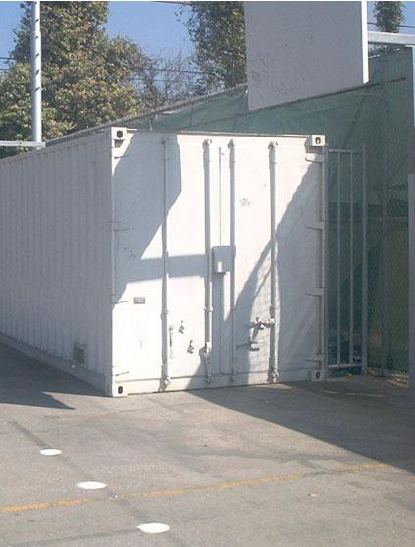

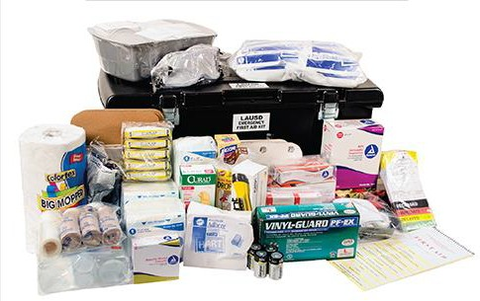
Key ISSP Components
Emergency Supplies and Equipment
Our school provides a minimum 72-hour supply of emergency water, food, first aid, search and rescue, sanitation and other emergency supplies and equipment.
We supplement our emergency supplies by placing
specific supplies in classrooms to be used during a
lockdown or shelter in place. These supplies consist of sanitation supplies, snack bars, bottled water, and
simple first aid supplies.
Notes:
(School adds details to the slide prior to the meeting.)
Facilitator states:
In order to properly respond to emergencies/threats/hazards, we will rely on specific supplies and equipment. Though not all of these will be needed for each emergency, we must be prepared.
All schools have a minimum 72-hour supply of emergency water, food, first aid, search and rescue, sanitation and other supplies and equipment.
Supplies are stored in classrooms and dedicated outdoor metal containers. (School should revise language in the slide as necessary.)
Emergency water is treated every three years.
Emergency supplies/equipment are inventoried at least twice a year to replace or replenish items, as necessary.

Slide 30
Key ISSP Components
Emergency Drills
Type | Elementary | Middle | Sr. High & Adult
Fire | First week* of school until proficient, then once per month* at minimum, including summer school. | First week* of school until proficient, then once per month* at minimum, including summer school. | First week* of school until proficient, then once per semester* at minimum, including summer school.
Lockdown | Within the first 30 days* of student inperson classes once per semester at minimum, including summer school. | Within the first 30 days* of student inperson classes once per semester at minimum, including summer school. | Within the first 30 days* of student inperson classes once per semester at minimum, including summer school.
Earthquake (Drop/Cover /Hold On) | Once per month* at minimum, including summer school. | Once per month* at minimum, including summer school. | Once per month* at minimum, including summer school.
Shelter-in-Place | Oral review or drill once per semester* at minimum, including summer school. | Oral review or drill once per semester* at minimum, including summer school. | Oral review or drill once per semester* at minimum, including summer school.
Notes:
Facilitator states:
To support our school in preparing for emergency response to some threats/hazards, we review and practice the response protocols.
As indicated in the table, four types of emergency drills are required; a radio test to evaluate our communications capabilities by hand-held radio is also required each semester.
The chart shows the expected drill frequency. Notice that fire drills are required once per month/semester (depending on school’s grade levels), while lockdown drills take place at the beginning of each semester. (Focus on the grade spans served at your school.)
Shelter in Place exercises can be done as an oral review instead of a drill.
Rapid Relocation Procedures for active shooter incidents (not listed in the table) are reviewed only with staff once per semester.
Background for facilitator/not necessary to share:
Each drill is documented through an online app.

Slide 31
Accessing the Print ISSP
Parents and community members can request to view any school’s ISSP.
Schools have a copy of their ISSP in the Main Office.
This copy must be viewed and remain in the Main Office.
All who view the ISSP public copy must enter their information in the viewing log.
Notes:
Facilitator states:
The District values transparency and collaboration with the community; at the same time, Ed Code also requires that the public have the opportunity to view a school’s ISSP.
At any time during the school year, a school employee, pupil’s parent, guardian, or educational rights holder, or pupil can request to review the ISSP and may bring concerns about an individual pupil’s ability to access disaster safety procedures in the ISSP to the principal.
If you are interested, (school enters staff member[s] name) in the Main Office can assist you with viewing the ISSP.
Background for facilitator/not necessary to share:
The copy/specific pages for public view is replaced each time the school makes updates to the ISSP since it is resubmitted at that time.
For safety reasons, maps are redacted from the public view copy.
School employees also have online access to the ISSP draft and final/submitted version.
The ISSP should not be posted on any website.
Ed Code 32282 (d): …An updated file of all safety-related plans and materials shall be readily available for inspection by the public.
CA E.C. §32282 authorizes a school employee, a pupil’s parent, guardian, or educational rights holder, or a pupil, to bring concerns about an individual pupil’s ability to access disaster safety procedures described in the ISSP. A concern is a call or written communication through which a school employee, pupil’s parent, guardian, or educational rights holder, or pupil expresses a matter of importance related to a pupil’s ability to access some aspect of disaster safety procedures as described or needed to be described in the ISSP. (See Attachment A in REF-5511 Completing and Updating the Integrated Safe School Plan 2024-25 for more details.)

Slide 32
Opportunities for Involvement
School Safety Committee membership
Volunteer for the ShakeOut or other drills, serving in a role such as, request/reunion gate team member
Assist with classroom supply kits
Assist with organizing the emergency bin
Notes:
Facilitator states (school revises slide as necessary):
If interested in committee membership for next year, contact (school enters staff member name[s]).
As a committee member, you will have the opportunity to assist our school with the ISSP.
You can also support the ISSP as a volunteer who are especially valuable at request and reunion gates (or school shares other possible roles).
Volunteers can also assist with the inventory and replenishing of classroom supply kits.
Volunteers can support our school with organizing the emergency bin in preparation for the ShakeOut as well as the fall and/or spring inventory.
Volunteers can also (school enters other ways they can assist with emergency preparedness).
Background for facilitator/not necessary to share:
Bin inventories are due January 31, 2024 and June 21, 2024.

Slide 33
Resources
Classroom Emergency Quick Guide
Spanish Classroom Emergency Quick Guide
Notes:
Facilitator states:
The Emergency Classroom Quick Guide is used by staff to remind them of drill procedures and protocol for actual emergencies as they respond and support their students.
You will notice that this document has the same information as that which is in the ISSP.
Background for facilitator/not necessary to share:
- All schools were provided a new version of this guide in August/September 2022. A new version is not created yearly; one will not be published in 2023-24. You do not need to request more guides if you have the fall 2022 version in your classrooms/common areas.

Slide 34
Resources
Parent Emergency Information
  lausd.org/PEI
  or ParentEmergencyInformation.lausd.net
Parent Emergency Guide
Notes:
Facilitator states:
These are some useful resources for parents.

Slide 35
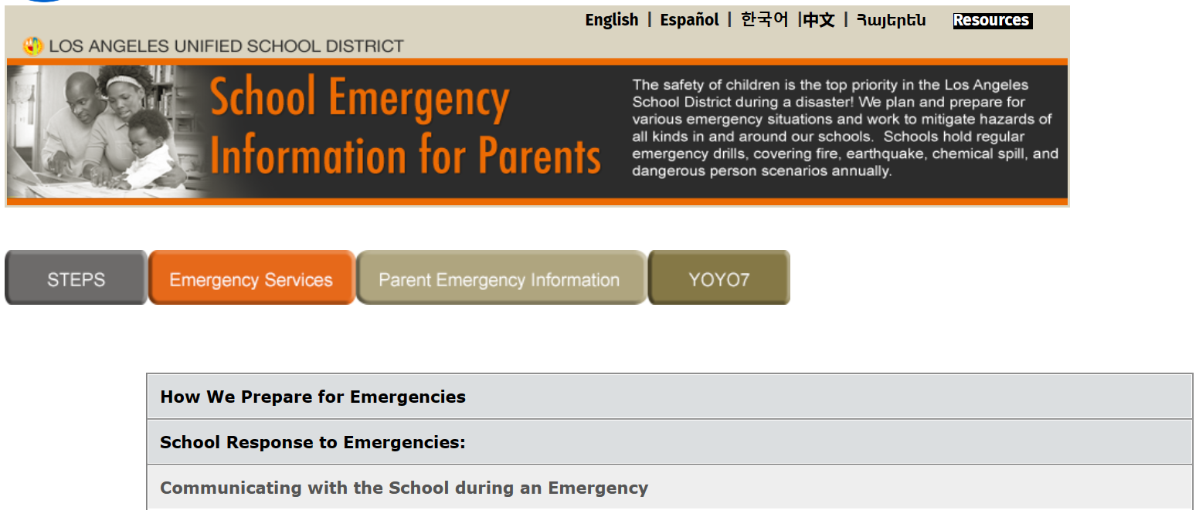
Resources
Parent Emergency Information
  lausd.org/PEI
  ParentEmergencyInformation.lausd.net
Notes:
Facilitator states:
The Parent Emergency Information webpage includes information on how the District/schools prepare and respond to emergencies, as well as how to communicate with the school during emergencies.
The page also describes the process for reunifying with your child.
Facilitator visits the webpage, if time permits, by clicking on the link: ParentEmergencyInformation.lausd.net.

Slide 36
Resources
Parent Emergency Guide
Notes:
Facilitator states:
- This guide provides key information regarding our school’s emergency procedures. (Consider printing copies of this document for parents.)
Some highlights from this guide include:
During an emergency, information will be provided to parents through Blackboard Connect automated phone calls and texts, District or school websites, email, local TV broadcast depending on the circumstances of the emergency.
School personnel are required by law to remain on duty for the duration of the emergency.
As a reminder, if coming to the school (for reunification), bring photo identification, cell phone (for updates) and medical information and medication (if applicable).
Ensure your emergency contact information is up-to-date at all times.

Slide 37
Questions
and
Public Comment
Notes:
Facilitator answers questions and provides opportunity for public comment.

Slide 38
School’s ISSP Contact
Enter school site contact information: Name
Position
Email address
Telephone number
Notes:
(School adds details to the slide prior to the meeting.)
Facilitator provides contact information.

Slide 39
We appreciate your participation today.

